Slide 2
Building great libraries using .NET Standard
Aaron Amm Theeranit
Senior Software Engineer

Slide 3
What is .NET Standard?

Slide 4
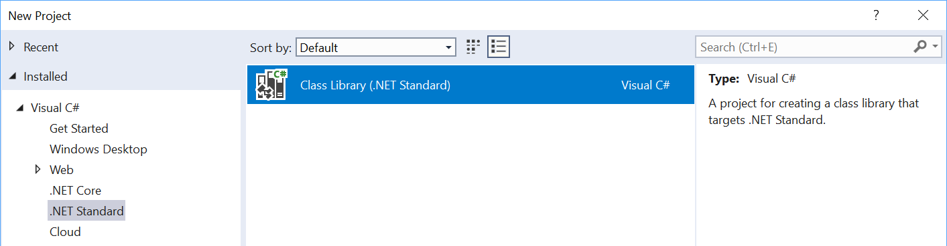
What is .NET Standard?
.NET Standard is a specification
A set of APIs all .NET platforms have to implement
.NET Standard
.NET Core
.NET Framework
Xamarin
~
~
HTML specification
Browsers

Slide 5
.NET Standard in context
.NET FRAMEWORK
.NET CORE
XAMARIN
.NET Standard

Slide 6
What’s in .NET Standard?
Microsoft.Win32.SafeHandles
System
System.CodeDom.Compiler
System.Collections
System.Collections.Concurrent
System.Collections.Generic
System.Collections.ObjectModel
System.Collections.Specialized
System.ComponentModel
System.ComponentModel.Design
System.ComponentModel.Design.Serialization
System.Configuration.Assemblies
System.Data
System.Data.Common
System.Data.SqlTypes
System.Diagnostics
System.Diagnostics.CodeAnalysis
System.Diagnostics.Contracts
System.Diagnostics.SymbolStore
System.Diagnostics.Tracing
System.Drawing
System.Dynamic
System.Globalization
System.IO
System.IO.Compression
System.IO.IsolatedStorage
System.IO.MemoryMappedFiles
System.IO.Pipes
System.Linq
System.Linq.Expressions
System.Net
System.Net.Cache
System.Net.Http
System.Net.Http.Headers
System.Net.Mail
System.Net.Mime
System.Net.NetworkInformation
System.Net.Security
System.Net.Sockets
System.Net.WebSockets
System.Numerics
System.Reflection
System.Reflection.Emit
System.Resources
System.Runtime
System.Runtime.CompilerServices
System.Runtime.ConstrainedExecution
System.Runtime.ExceptionServices
System.Runtime.InteropServices
System.Runtime.InteropServices.ComTypes
System.Runtime.Serialization
System.Runtime.Serialization.Formatters
System.Runtime.Serialization.Formatters.Binary
System.Runtime.Serialization.Json
System.Runtime.Versioning
System.Security
System.Security.Authentication
System.Security.Authentication.ExtendedProtection
System.Security.Claims
System.Security.Cryptography
System.Security.Cryptography.X509Certificates
System.Security.Permissions
System.Security.Principal
System.Text
System.Text.RegularExpressions
System.Threading
System.Threading.Tasks
System.Timers
System.Transactions
System.Windows.Input
System.Xml
System.Xml.Linq
System.Xml.Resolvers
System.Xml.Schema
System.Xml.Serialization
System.Xml.XPath
System.Xml.Xsl
All the foundational APIs
~37k APIs in .NET Standard 2.0

Slide 7
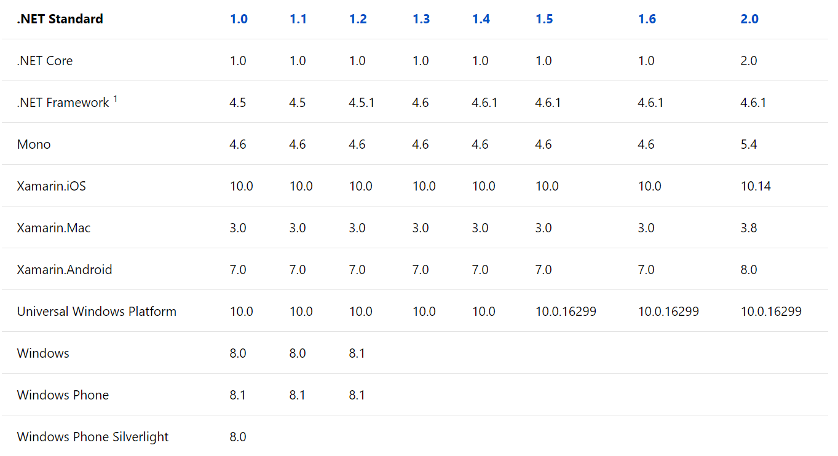
Versions of .NET Standard
Don’t worry about it.
Start with .NET Standard 2.0.

Slide 8
.NET Standard is also Open Source!
Next version is planned here:
https://github.com/dotnet/standard/tree/master/docs/planning/netstandard-2.1

Slide 9
Minimum requirement
Visual Studio 2017
Use package reference not a nuget package.config

Slide 10
Using platform-specific APIs from .NET Standard

Slide 11
Windows Compatibility Pack
Microsoft.Windows.Compatibility (NuGet package)
Can be referenced from .NET Core as well as from .NET Standard
Has ~21k APIs (Windows-only as well as cross-platform)
Contents
ACLs
Code Pages
CodeDom
Configuration
Crypto
DirectoryServices
Drawing
EventLog
MEF v1
Odbc
Perf Counters
Permissions
Ports
Registry
Runtime Caching
WCF
Windows Services
…

Slide 12
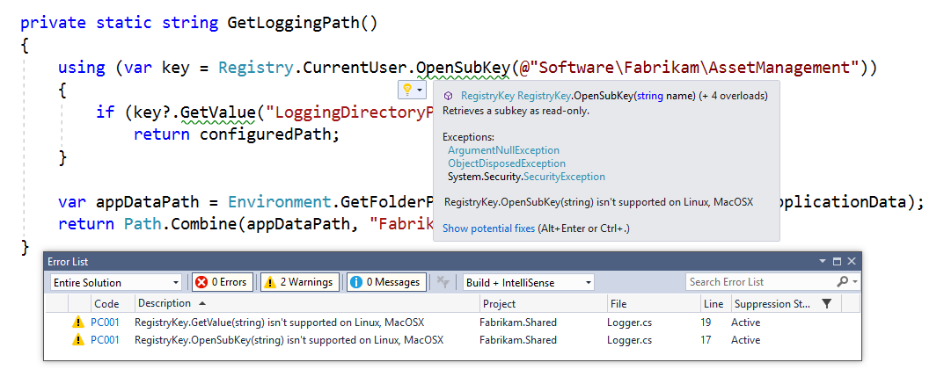
Detecting usage of unsupported APIs
Use API Analyzer!
https://aka.ms/apianalyzer
Roslyn analyzer that flags usages of APIs that don’t work across all platforms

Slide 13
Multi-Targeting Best Practices
DO start with .NET Standard 2.0
Most general purpose libraries will not need APIs outside this set.
CONSIDER targeting multiple frameworks
If you need to call platform-specific APIs outside of .NET Standard
DO NOT drop support for .NET Standard
Instead, throw from the implementation and offer capability APIs. This way, your library can used anywhere and supports runtime light-up.
DO share your component using a NuGet package
It shields consumers from having to pick the appropriate implementation.
CONSIDER using MSBuild.Sdk.Extras
Thanks Oren! ☺

Slide 14
.NET Standard & .NET Framework

Slide 15
Sorry.
We retroactively made .NET Framework 4.6.1 support .NET Standard 2.0
Turns out this was a mistake as it has a tail of issues.
Lesson learned for us: after a .NET platform has shipped, the version of .NET Standard it supports should be considered immutable.
.NET Framework 4.7.2 is the recommended version to consume .NET Standard 1.5+
Application authors: consider upgrading
Library authors: consider multi-targeting for .NET Framework 4.6.1

Slide 16
Targeting .NET 4.6.1 to use .NET Standard 2.0

Slide 17
Versioning

Slide 18
Versioning
You need to know about four version numbers:
Kind | When to increment | Comment
Package Version | Every change | The ID of the NuGet package.
Assembly Version | As you see fit | The version number of the assembly. Used by the loader to resolve assemblies.
File Version | Every change | Generic concept, used by installers to determine which file is newer.
Informational Version | As you see fit | Display string, doesn’t need to be a version.

Slide 19
Best Practices
DO follow the API Design Guidelines
DO target .NET Standard 2.0
CONSIDER using multi-targeting to allow for platform-specific code
CONSIDER dual-targeting for .NET Framework 4.6.1
DO use NuGet for packaging multi-targeted libraries
DO throw PlatformNotSupportedException for unsupported APIs
CONSIDER offering capability APIs so that consumers can check upfront
DO strong name your libraries
AVOID if your library can’t be used on .NET Framework
DO check in the public & private key

Slide 20

Q & A
http://codesanook.com
https://fb.com/codesanookpage
https://fb.com/groups/codesanook
Aaron Amm Theeranit
theeranitp@gmail.com

Slide 21
Likely questions
How to build documentation?
How to build NuGet packages?
Why would I target .NET Core instead of .NET Standard?
Why is it worth targeting 2.0 if you already target 1.x?
Will .NET Standard 2.1 be supported on .NET Core 2.1+?
Will .NET Standard 2.1 be supported on .NET Framework?
Why is cross-referencing problematic and when should you use it?
What are the differences between package version, assembly version, assembly file version and product version? When should I increment what?

Slide 22
What can you reference from .NET Standard?
.NET FRAMEWORK
.NET CORE
XAMARIN
Legend
My Standard Library 2.x
Is able to reference
Application Type
Via Portability
.NET Standard Library
Portable Class Library
.NET Framework Library
Via Compatibility Shim

Slide 23
.NET Standard under the hood
YOUR .NET STANDARD-BASED CLASS LIBRARY
NETSTANDARD.DLL
TYPE
FORWARDING
.NET FRAMEWORK OR PORTABLE CLASS LIBRARY
EXISTING .NET FRAMEWORK CLASS LIBRARY
MSCORLIB.DLL
MSCORLIB.DLL
MSCORLIB.DLL
FRAMEWORK ASSEMBLIES
This happens when you build a .NET Standard-based Library

Slide 24
.NET Standard under the hood
YOUR .NET APPLICATION
FRAMEWORK ASSEMBLIES
TYPE
FORWARDING
YOUR .NET STANDARD-BASED CLASS LIBRARY
NETSTANDARD.DLL
This happens when you load .NET Standard-based library

Slide 25
Platform specific APIs & .NET Standard
YOUR .NET STANDARD-BASED CLASS LIBRARY
NETSTANDARD.DLL
TYPE
FORWARDING
TYPE
FORWARDING
PLATFORM-SPECIFIC EXTENSION
REGISTRY.DLL
MSCORLIB.DLL
MSCORLIB.DLL
MSCORLIB.DLL
FRAMEWORK ASSEMBLIES
This happens when you build a .NET Standard-based library with platform-specific extensions

Slide 26
Platform specific APIs & .NET Standard
YOUR .NET APPLICATION
FRAMEWORK ASSEMBLIES
YOUR .NET STANDARD-BASED CLASS LIBRARY
SUPPORTED EXTENSION
TYPE
FORWARDING
EXCEPTION
UNSUPPORTED EXTENSION
This happens when you load .NET Standard-based library with platform-specific extensions

